Slide 1
WELC Chapter 9
(Breaking Dependencies) p2
Breaking out of Global Dependencies, Import Dependencies and Nested Inheritance Dependencies
Kwong Brian (April 29th 2025)

Slide 2
Overview
Review of Global Dependencies and Singletons
How to Break Free from Global Dependencies while Testing
Working with Import Dependencies
Onion Parameters
Alias Parameters
Breaking Free of Parameter Dependencies

Slide 3
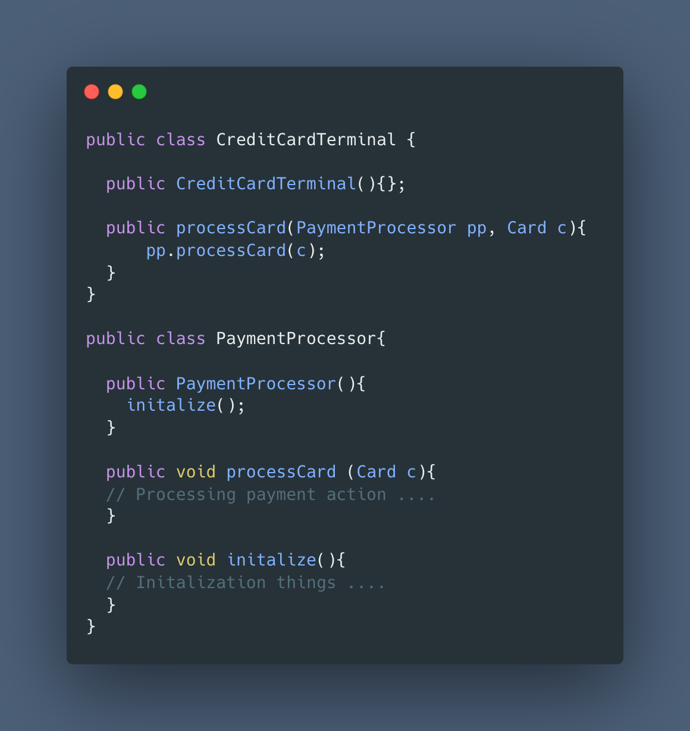
What is a Global Dependency?
In programing a dependency is a object is passed into a function or class in order to enable/provide functionality of that method or class.
Often this is done by passing the necessary object as a reference, then using the object’s methods to complete the task.
In UML class diagrams dependencies are marked as dotted arrows from class A (the supplier) to
A global dependency is a variable and/or class that is declared at a global scope and share accessed is granted throughout the program
Global dependencies are particularly hard to break free from as they are often tightly coupled to large parts of the programs and their usages are scattered throughout.

Slide 4
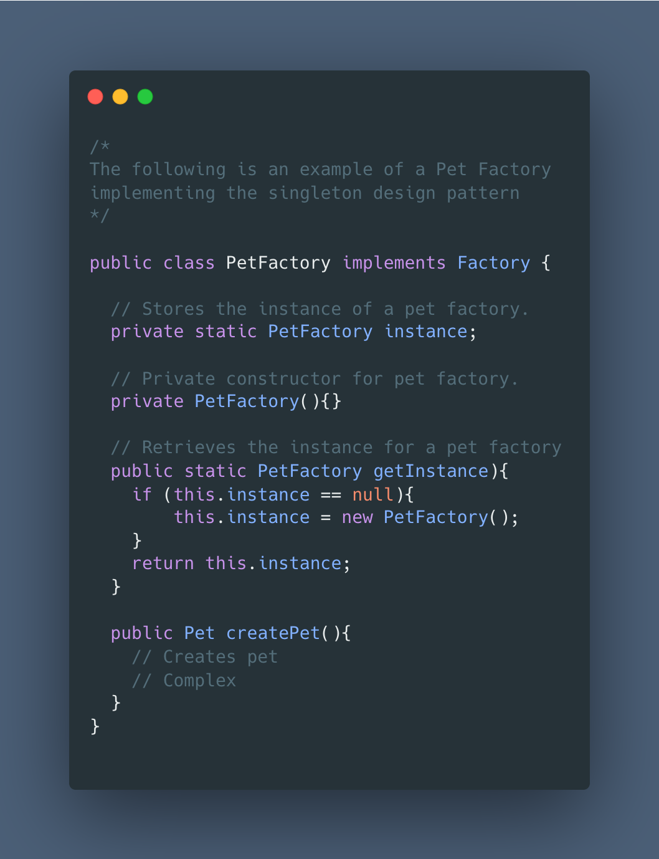
The Singleton
The singleton is a design pattern where there is at most one object of a particular type throughout the entire application.
The first time the singleton is called (generally through a method called `getInstance`), the object is initialized; otherwise, the previously created object is used.
Singletons are often used when a single instance of an object is desired or as a simple way to create global instances in an OOP language such as Java.
Database Connections
Authentication Clients
Users of a SUA
Factories
Loggers
Singletons are particularly challenging to unit-test because there is a single global instance that is consistent throughout all tests.
It is hard to inject our own instance for the object to set particular parameters for testing scenarios .

Slide 5
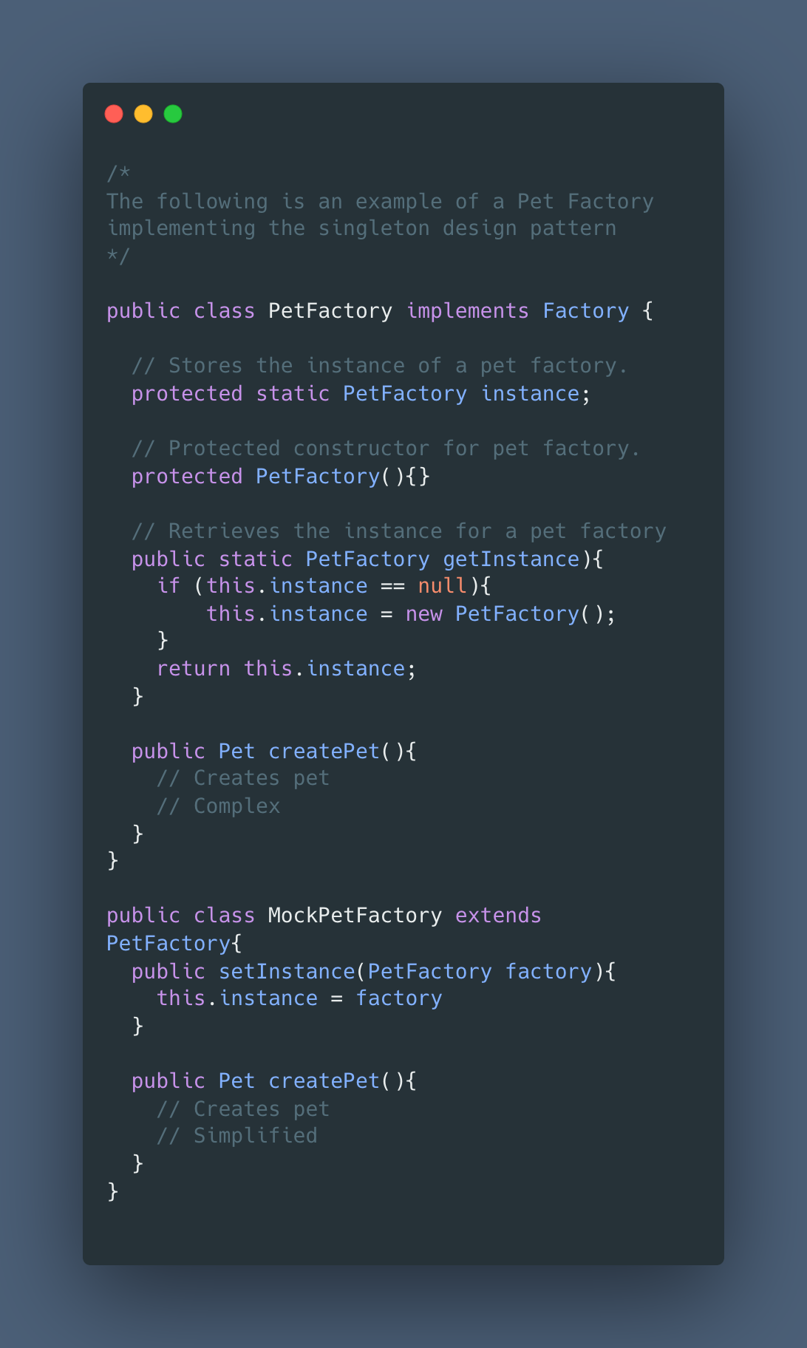
Breaking Dependencies w/ Singleton
There are two primary ways to work with breaking dependencies of a singleton.
Is the Singleton property necessary?
🟩 No
Relax the singleton property by making the constructor public, creating a new instance, and allowing the setting of a new instance.
[Optionally] you can convert the class to a regular class.
🟨 Yes
Permeate the class constructor and instance variable from private —> protected.
Create a child class of the singleton (used only for testing purposes).
Write a setter for the instance in the child class.
If there are a large number of global instance variables , then there may be deeper structural deficiencies in the code, such as failing to follow SRP.

Slide 6
Demo Part 1

Slide 7
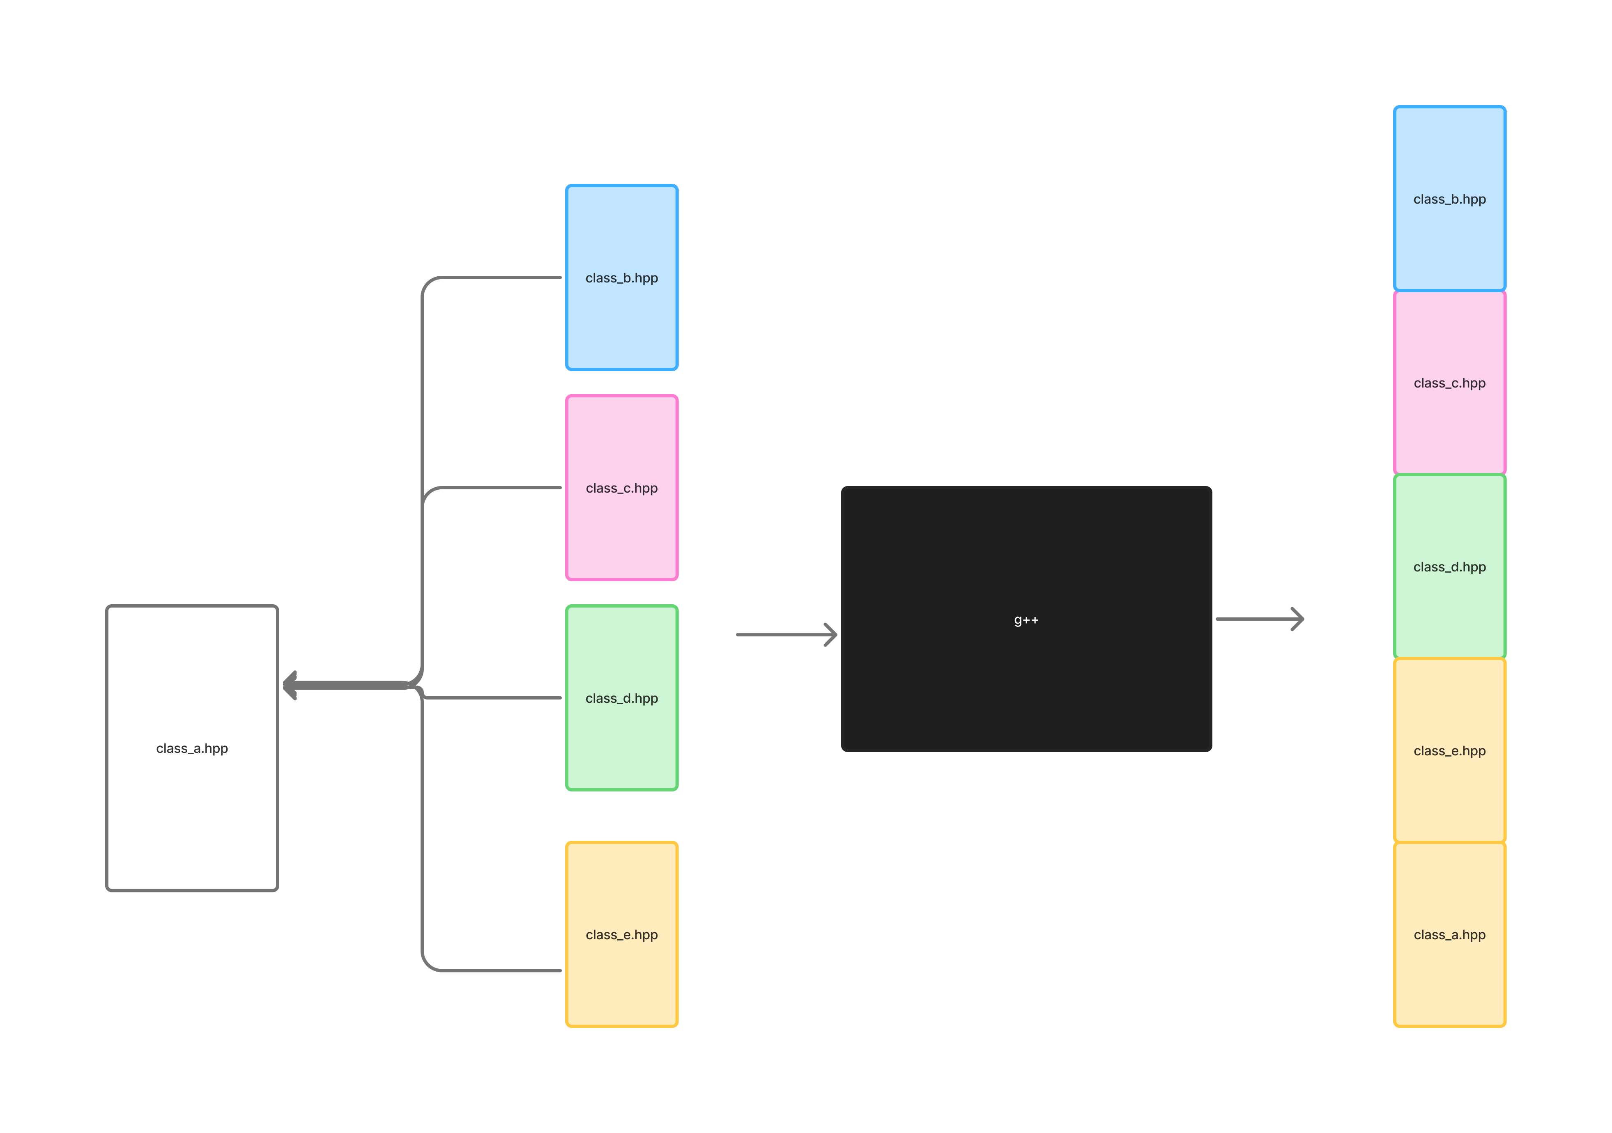
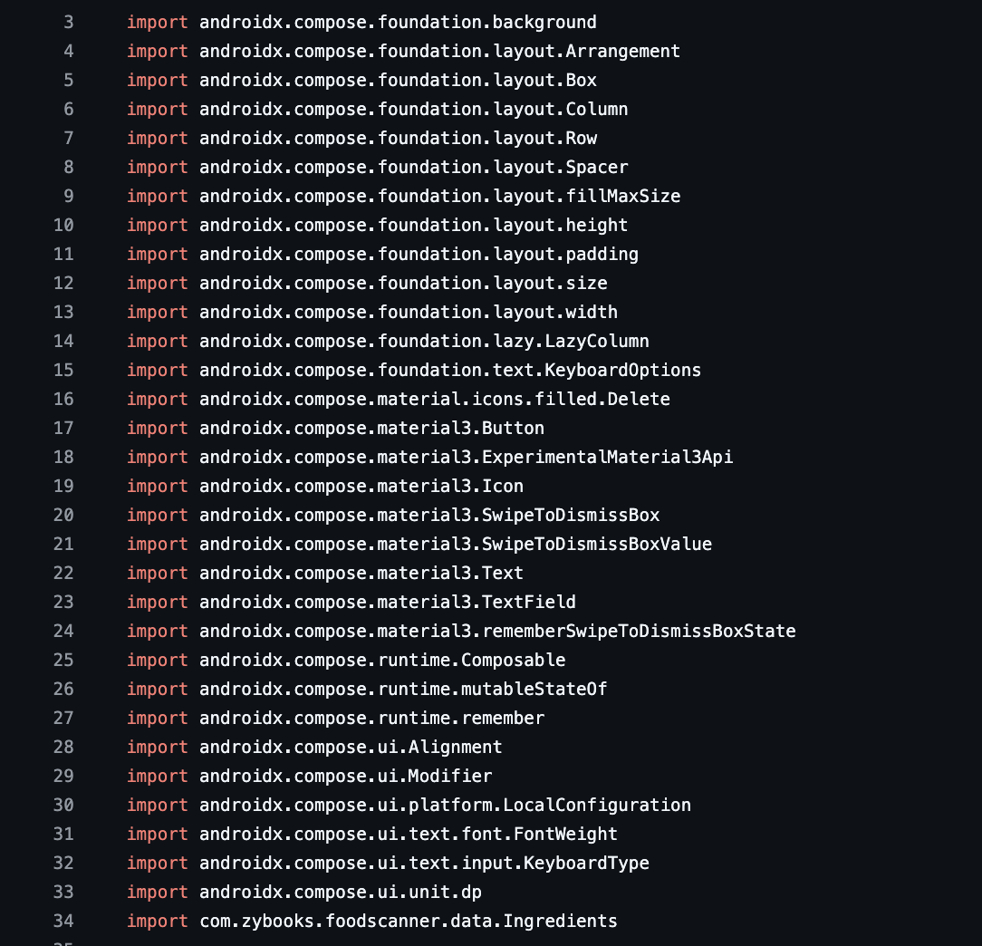
Working with Import Dependencies
Often when working with large projects, there are a variety of imports from either from other parts of our codebase (potentially legacy) or external libraries from other developers.
External code is not as portable as it’s often described. Instead, “..plenty of commercial and open-source frameworks … are not really things that we use; they are things that use our code” (WELC, 118)
This becomes particularly problematic in older languages which may not have the optimization to pull declarations from previously compiled code.

Slide 8
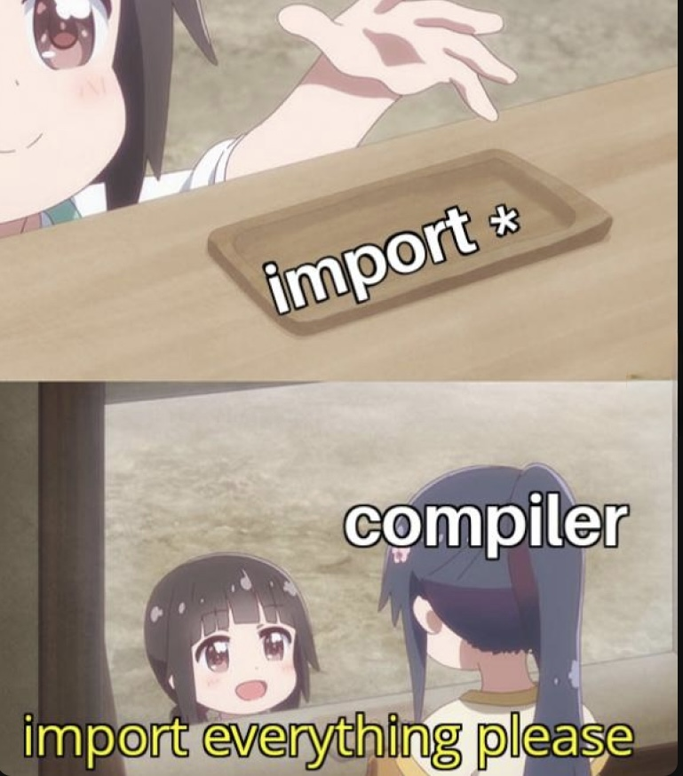
Import Dependencies Continued
Legacy codebases often have their required dependencies hidden in their source code instead of shared header files.
Eliminate as many “dead” parameters and imports as possible.
Use packages and dynamic libraries (.so/.dlls) to keep code isolated and modular.
Consider making a “Testing” specific header/source file that overrides specific tricky-to-mock methods and only implements necessary functions.
In some languages, you can also declare classes within functions and other classes for temporary use.

Slide 9
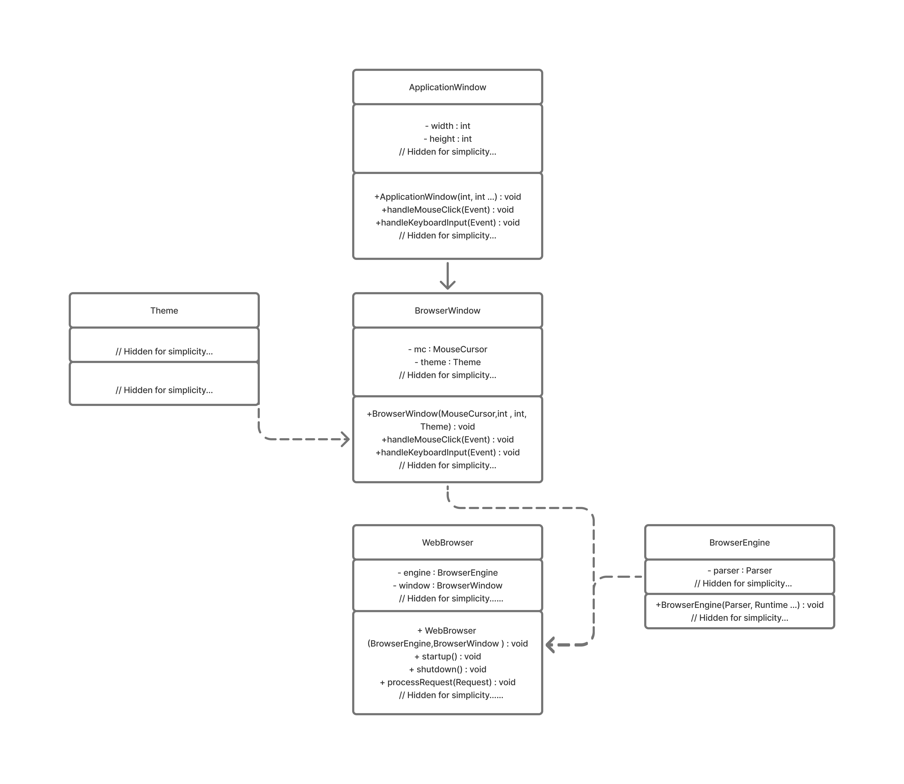
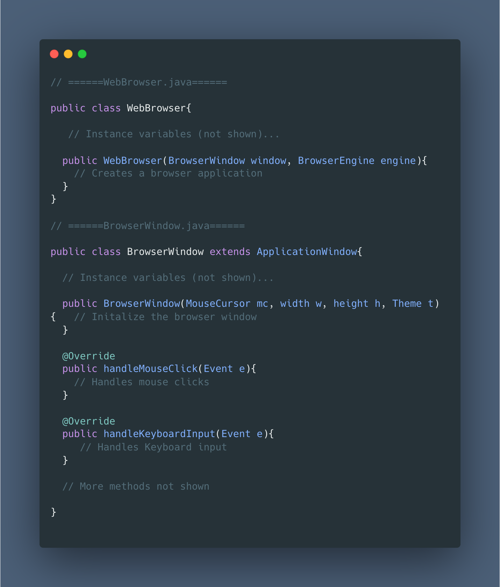
Onion Parameters
Parameters of a constructor of an object often require other objects.
These objects themselves depend on other smaller objects for their creation.
Nested objects are challenging to unit test as they require a lot of setup to evaluate a single function.
Not all classes can be cleanly broken into interfaces as they are nested in a deep hierarchy.

Slide 10
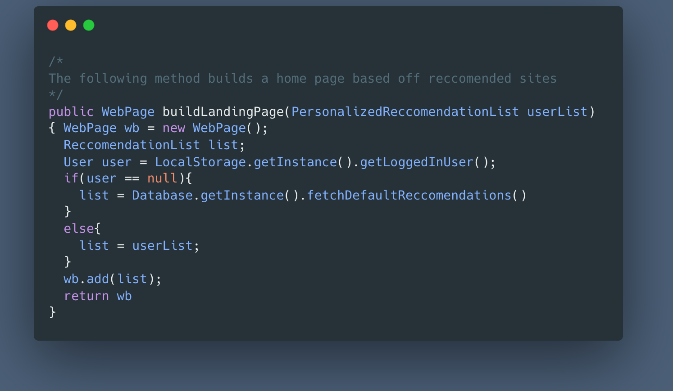

Alias Parameters
An alias parameter is a parameter that is changed inside the method or different variants of a parameter are used depending on non-controllable conditional logic/factors.
Examples
The type of building permit returned may depend on a whether it exists in the current database
The browser engine may be dependent on our computer’s architecture and system load.
Alias Parameters prevent us from injecting and controlling our own mock data

Slide 11
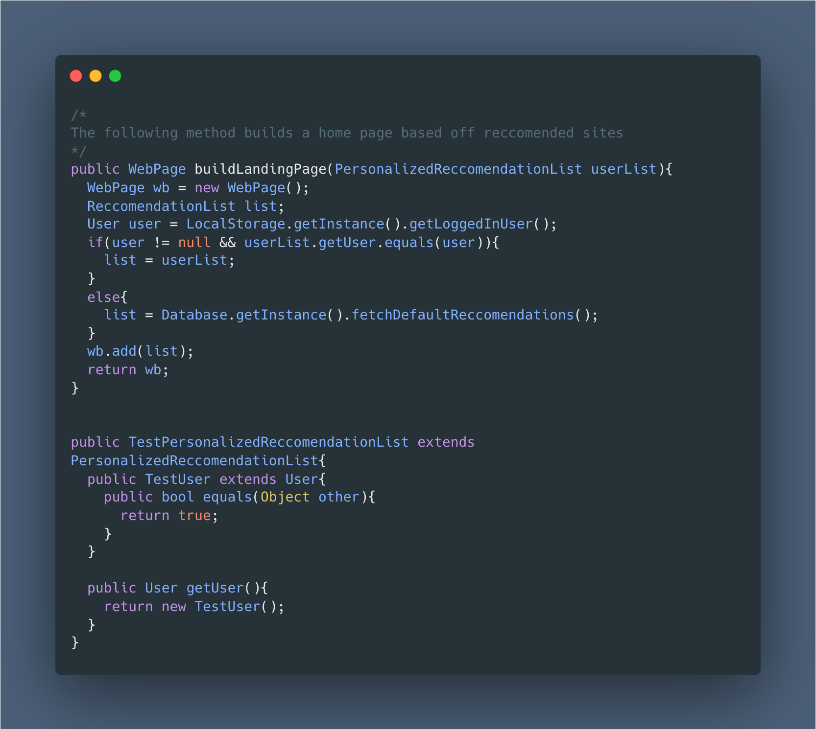
Resolving Onion and Alias Parameters
Non-necessary Parameters :
Pass `null` into the parameter field.
Complex Parameters (Extract Interface Method):
Create an interface for the public methods of the troublesome parameter.
Make the original class implement the interface.
Fork a new class that also implements that interface and override the necessary methods with more test-friendly variants.
Update the method to take the
Deeply Nested Parameters (Subclass and Override Method):
Create a subclass of the class with the troublesome parameter.
Override the method you want to prevent aliasing.

Slide 12
Demo Part 2

Slide 13

Applications in Our Projects
Database and Authentication Services
Testing Complex Simulation Classes
Mocking and working with a variety of different pets

Slide 14
Thank You!

Slide 15
References
Feathers, Michael C. Working Effectively with Legacy Code. Upper Saddle River, N.J, Prentice Hall Ptr, 2013.

